Slide 1
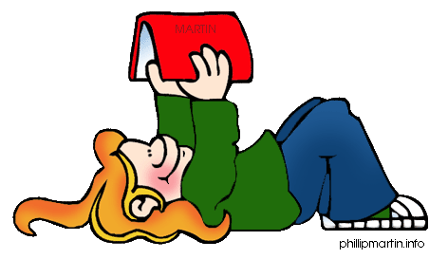
Parent Workshop
26th September 2022

Slide 2


"At the end of the day the most overwhelming key to a child’s success is the positive involvement of parents."

Slide 3
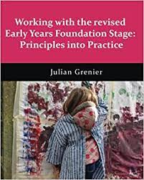
“Development Matters” written by Julian Grenier
An important aspect of the curriculum is self-regulation and executive functioning. This includes the child's ability to -
Hold information in their mind
Focus their attention
Regulate their behaviour
Plan what to do next
There is now more focus on number sense and understanding.
There is no longer an exceeding assessment at the end of the year. More of a focus on those children who may not reach ELG.

Slide 4

Reading and phonics

Slide 5
Word reading
By the end of their Reception year the children should be able to:
Say a sound for each letter of the alphabet and at least 10 digraphs
Read words consistent with their phonic knowledge by sound blending.
Read aloud simple sentences and books that are consistent with their phonic knowledge, including some common exception words.

Slide 6

What do we do in school to teach a love of books and stories?
Read books daily with the whole class and talk about the stories. Children then have opportunities to access these books individually.
Role play activities to act out stories, reading books with individuals, listening station with story CDs, trips to the school library with older children, reading books at home.
Daily phonics teaching which includes guided reading.
This Photo by Unknown author is licensed under CC BY-NC-ND.

Slide 7
Letters and Sounds
Sessions are fast paced, active, fun and engaging with lots of follow up in child led time.
Daily session.
Articulation of phonemes http://www.highercallprimary.co.uk/
Phase 1 – sound discrimination, rhythm and rhyme, alliteration, voice sounds and oral blending and segmenting.
Phase 2 – letters s, a, t, p, i, n, m, d, g, o, c, k, ck, e, u, r, h, b, f, ff, l, ll, ss
Phase 3 – ch, sh, th, ng, ai, ee, igh, oa, oo, ar, or, ur, ow, oi, ear, air, ure, er
Phase 4 – tricky words, building CVC, CVCC, CCVC words.
High frequency words (e.g dad, the) will be taught through all phases.
https://www.phonicbooks.co.uk/2011/01/17/what-is-a-phoneme/

Slide 8
Phonics terms your child will hear in school………
Phonemes: The smallest units of sound that are found within a word.
Grapheme: A grapheme is a letter or a number of letters that represent a sound (phoneme) sh ch.
Digraph: Two letters that make one sound when read.
Trigraph: Three letters that make one sound.
CVC: Stands for consonant, vowel, consonant.
Segmenting: breaking up a word into its sounds.
Blending : Putting the sounds together to read a word.
Tricky words: Words that cannot easily be decoded.

Slide 9
What does a phonics lesson look like?
We start on the carpet, review all learned phonemes and then introduce new sounds.
Then we move to the tables and practice writing the new sound.
The children then write words and eventually sentences containing the new sound.
Once the children have learnt the first set of sounds, we begin to build and read words.
The children then read a book in pairs which contains the new sound and teachers support the groups listening to children as they read.

Slide 10
Book bags
The children will bring home a reading book which features the phonemes they have been learning that week.
Try to read at least 5 times a week.
Make comments in the reading diary and let us know how our child is doing.
Phonics Bug - https://www.activelearnprimary.co.uk/login?e=-1&c=0
Edshed –
https://www.edshed.com

Slide 11
What you can do at home.
Read as part of your daily routine.
Model reading as something enjoyable, important and useful – newspapers, magazines, menus, recipes, instructions, comics, signs, labels, information, timetables etc.
Look for print in the environment – signs, labels etc.
Visit the library.
Read books from your own collections and favourites at home.

Slide 12

Any questions?

Slide 13

Writing

Slide 14
As soon as your child starts to make marks, they are writers.
Writing is a developmental process; a journey.
Some children find this easy, and others take a while to develop the strength and control to form letters correctly.

Slide 15

There is a strong emphasis on the physical development of children in supporting their writing and mark making.
They need lots of gross motor activities to strengthen their shoulders and arms to support a firm pencil grip.
Lots of running, jumping, swimming, climbing, bike riding, rolling and large mark making.
Using an easel, writing on large paper on the floor, a variety of mark making tools.

Slide 16
By the end of their Reception year children should be able to:
Write
Write recognisable letters most of which are correctly formed.
Spell
Spell words by identifying the sounds in them and representing the sound with a letter or letters.
Write
Write simple phrases and sentences that can be read by themselves and others.

Slide 17
What do we do in school to encourage mark making?
Mark making materials available to all children
Easel, paint, chalks, pens, pencils, clipboards etc.
In phonics lessons children begin by writing sounds, then words, then dictated sentences.
They will start to use these skills in their independent writing as their skills develop.
Drawing and writing as part of our literacy sessions.
What do we do in school to encourage mark making?

Slide 18
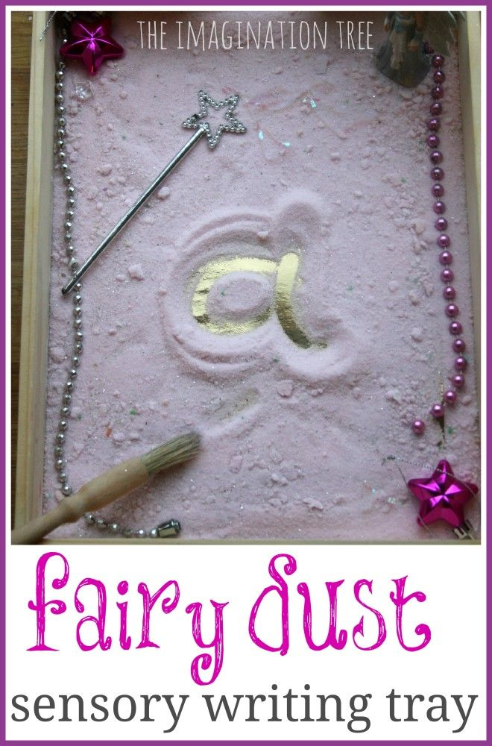
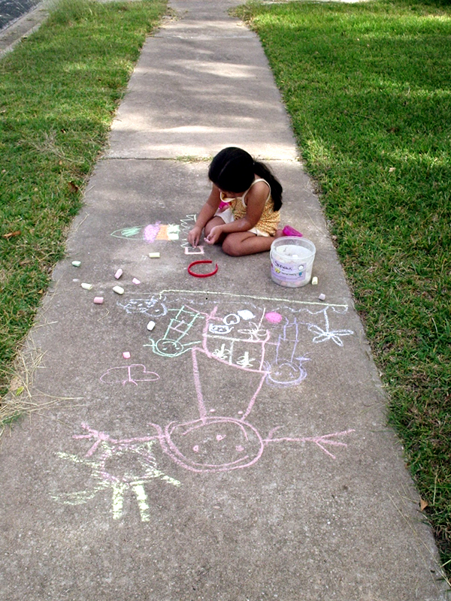
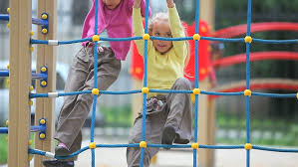

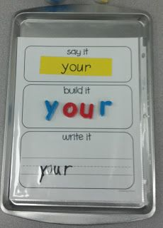
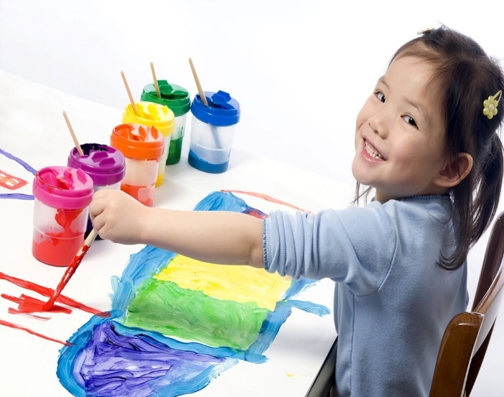
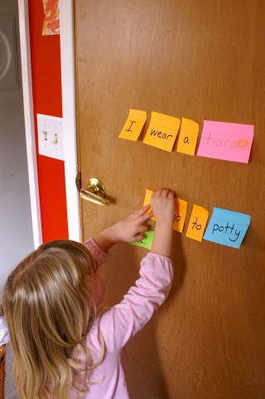
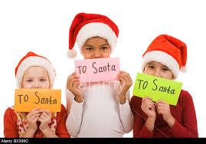
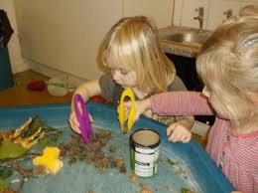
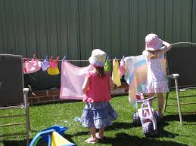
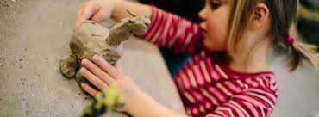

Slide 19
Any questions?

Slide 20

Maths

Slide 21
By the end of their reception year children should be able to :
Have a deep understanding of number to 10, including the composition of each number.
Subitise (recognise quantities without counting) to 5.
Automatically recall number bonds up to 5 (including subtraction facts) and some number bonds to 10.
Verbally count beyond 20, recognising the pattern of the counting system.
Compare quantities up to 10 in different contexts and be able to say which is greater than, less than or the same.
Explore and represent patterns within numbers to 10, including odds and evens, doubles and sharing.

Slide 22
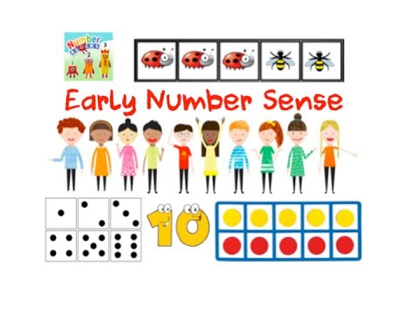
Number

Slide 23
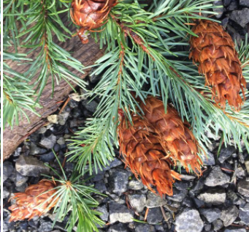
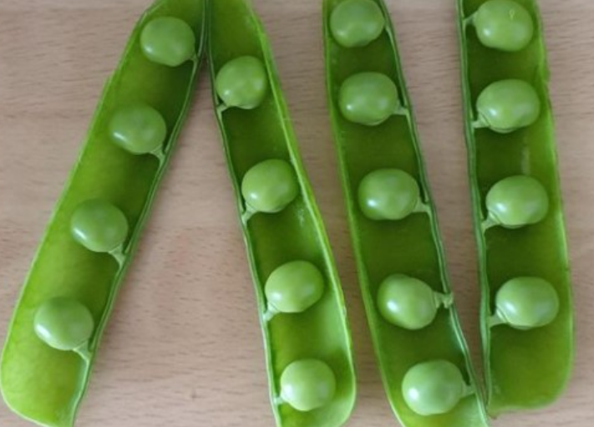
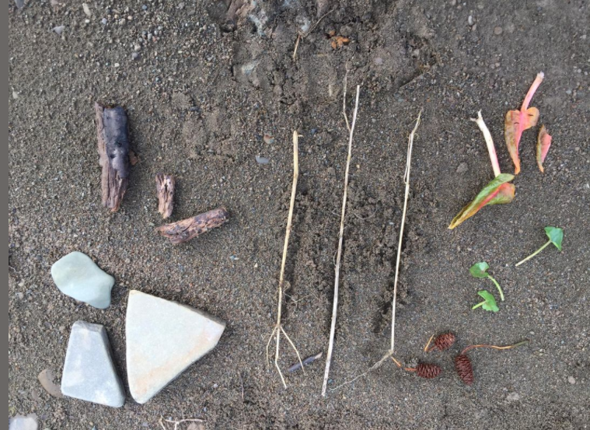

Slide 24
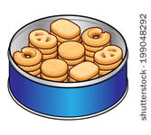
Then they can solve simple problems involving number and answer questions.
I had 5 biscuits. I ate 2. How many were left?

Slide 25
The children can then learn some useful number facts like number bonds to 10….
1 + 9 =
2 + 8 =
3 + 7 =
4 + 6 =
5 + 5 =

Slide 26
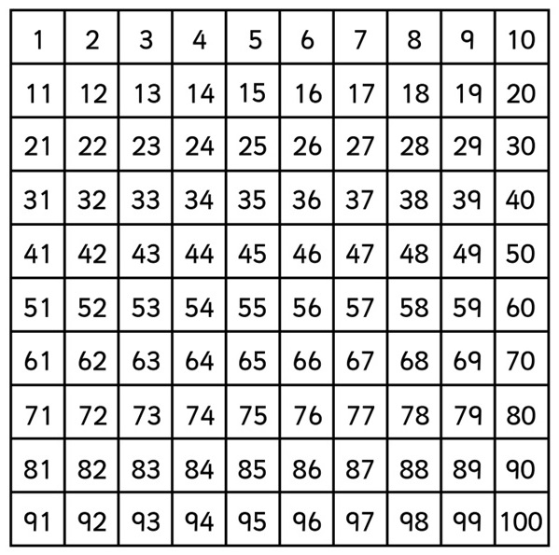
Counting beyond 10….

Slide 27
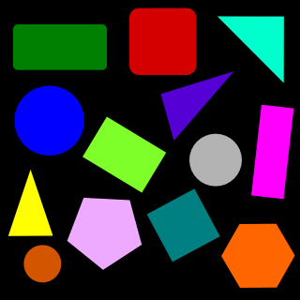


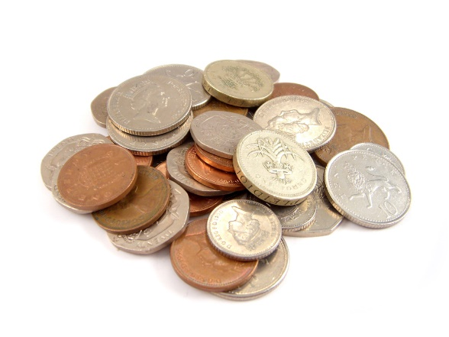

They also need experience of shape, measure and space.

Slide 28







What can you do at home?

Slide 29
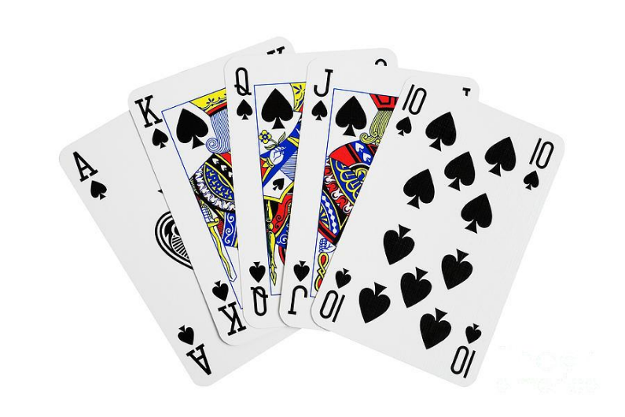
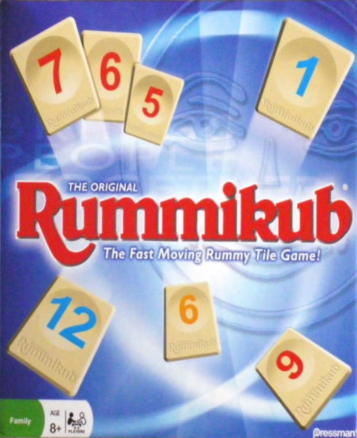
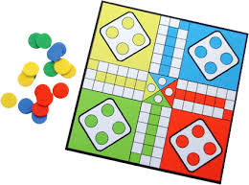
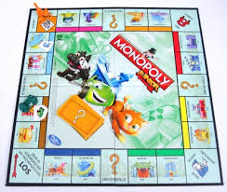
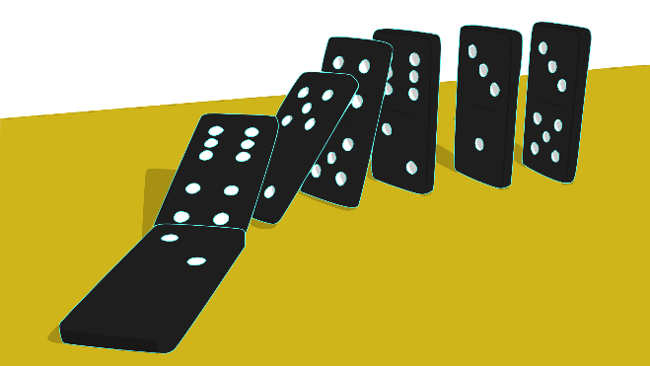
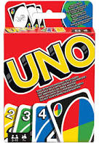

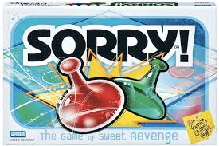

Slide 30
Any questions?

Slide 31

Thank you for coming.

